Slide 1
CUSTOMER RELATIONSHIP MANAGEMENT
CONCEPTS AND TECHNOLOGIES
Chapter 5
Customer Portfolio Management

Slide 2
Customer Portfolio definition
A customer portfolio is the collection of mutually exclusive customer groups that comprise a business’s entire customer base.

Slide 3
Objectives of Customer Portfolio Management (CPM)
CPM aims to optimise business performance – whether that means sales growth, enhanced customer profitability, or something else - across the entire customer base.
It does this by offering differentiated value propositions to different segments of customers.

Slide 4
Basic disciplines for CPM
market segmentation
sales forecasting
activity-based costing
customer life-time value estimation
data-mining

Slide 5
Market segmentation definition
Market segmentation is the process of dividing up a market into more-or-less homogenous subsets for which it is possible to create different value propositions.

Slide 6
Intuitive vs. data-based segmentation
Intuitive
  brain-storm segmentation variables
    age, gender, life-style
    SIC, size, location
  produce word-profiles
  compute sizes of segments
  assess company/segment fit
  make targeting decision
    one/several/all segments?
Data-based
  Obtain customer data
    Internal and external
  analyse customer data
  identify high/medium/low value customer segments
  profile customers within segments
    age, gender, life-style
    SIC, size, location
  assess company/segment fit
  make targeting decision
    one/several/all segments?

Slide 7
Market segmentation process
identify the business you are in
identify relevant segmentation variables
analyse the market using these variables
assess the value of the market segments
select target market(s) to serve

Slide 8
Types of competitor (kitchen furniture example)
Benefit competitors
  other companies delivering the same benefit to customers. These might include window replacement companies, heating and air-conditioning companies and bathroom renovation companies
Product competitors
  other companies marketing kitchens to customers seeking the same benefit.
Geographic competitors
  these are benefit and product competitors operating in the same geographic territory

Slide 9
Criteria for segmenting consumer markets
User attributes | Demographic attributes: age, gender, occupational status, household size, marital status, terminal educational age, household income, stage of family life-cycle, religion, ethnic origin, nationality Geographic attributes: country, region, TV region, city, city size, post-code, residential neighbourhood Psychographic attributes: life-style, personality
Usage attributes | Benefits sought, volume consumed, share of category spend

Slide 10
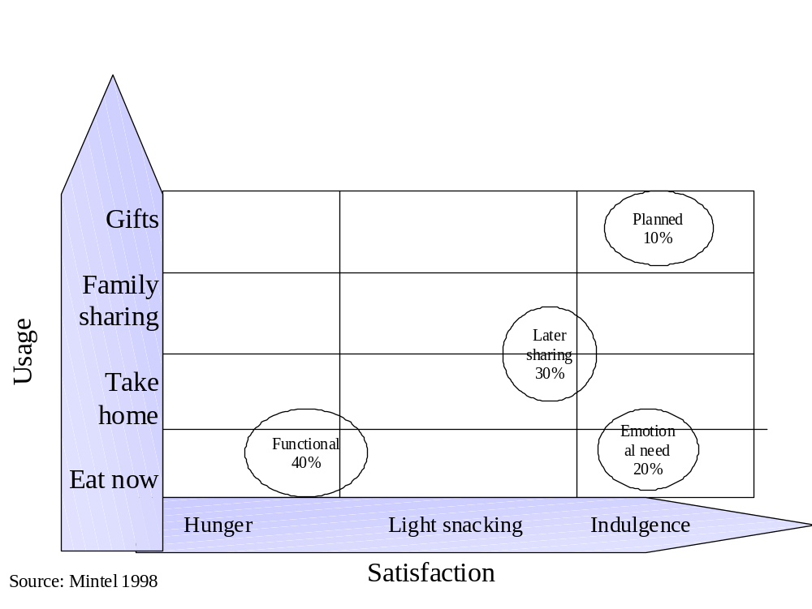
Bivariate segmentation of the chocolate market

Slide 11
Criteria for segmenting business markets
Business market segmentation criteria | Illustration
International Standard Industrial Classification | An internationally agreed standard for classifying goods and service producers
Dispersion | Geographically concentrated or dispersed
Size | Large, medium, small businesses: classified by number of employees, number of customers, profit or turnover
Account status | Global account, National account, Regional account, A or B or C class accounts
Account value | <$50,000, <$100,000, <$200,000, <$500,000
Buying processes | Open tender, sealed bid, internet auction, centralized, decentralized
Buying criteria | Continuity of supply (reliability), product quality, price, customisation, just-in-time, service support before or after sale
Propensity to switch | Satisfied with current suppliers, Dissatisfied
Share of customer spend in the category | Sole supplier, majority supplier, minority supplier, non-supplier
Geography | City, region, country, trading bloc (ASEAN, EU)
Buying style | Risk averse, innovator

Slide 12
Examples of ISIC codes
ISIC 4-digit code | Activity
1200 | Mining of uranium and thorium ores
2511 | Manufacture of rubber tyres and tubes; re-treading and rebuilding of rubber tyres
5520 | Restaurants, bars and canteens
8030 | Higher education

Slide 13
McKinsey/GE customer portfolio matrix
High
Attractiveness of
market segment
Medium
Low
Strong
Average
Weak
Fit to company and network competencies
Attractive
markets
Medium-priority
markets
Unattractive
markets

Slide 14
Sales forecasting methods
Qualitative methods
  Customer surveys
  Sales team estimates
Time-series methods
  Moving average
  Exponential smoothing
  Time-series decomposition
Causal methods
  Leading indicators
  Regression models

Slide 15
Sales forecasting using moving averages
Year | Sales volumes | 2-year moving average | 4-year moving average
2002 | 4830
2003 | 4930
2004 | 4870 | 4880
2005 | 5210 | 4900
2006 | 5330 | 5040 | 4960
2007 | 5660 | 5270 | 5085
2008 | 5440 | 5495 | 5267
2009 |  | 5550 | 5410

Slide 16
Costs vary over the customer base 1
Customer acquisition costs.
  Some customers require considerable sales effort to shift them from prospect to first-time customer status: more sales calls, visits to reference customer sites, free samples, engineering advice, guarantees that switching costs will be met by the vendor.
Terms of trade.
  Price discounts, advertising and promotion support, slotting allowances (cash paid to retailers for shelf-space), extended invoice due-dates.

Slide 17
Costs vary over the customer base 2
Customer service costs.
  Handling queries, claims and complaints, demands on sales-person and contact centre, small order sizes, high order frequency, just-in-time delivery, part-load shipments, breaking bulk for delivery to multiple sites.
Working capital costs.
  Carrying inventory for the customer, cost of credit.

Slide 18
ABC in a claims processing department
General ledger: claims processing department
ABC view: claims processing dept.
$ $ $
Actual Plan Variance
$
Key/scan claims 31,500
Analyse claims 121,000
Suspend claims 32,500
Receive provider enquiries 101,500
Resolve member problems 83,400
Process batches 45,000
Determine eligibility 119,000
Make copies 145,500
Write correspondence 77,100
Attend training 158,000
Total 914,500
Salaries 620,400 600,000 (21,400)
Equipment 161,200 150,000 (11,200)
Travel expenses 58,000 60,000 2,000
Supplies 43,900 40,000 (3,900)
Use & Occupancy 30,000 30,000 -----
Total 914,500 880,000 (34,500)

Slide 19
How ABC helps CPM
When combined with revenue figures, it tells you the absolute and relative levels of profit generated by each customer, segment or cohort
It guides you towards actions that can be taken to return customers to profit.
It helps prioritise and direct customer acquisition, retention and development strategies
It helps establish whether customisation, and other forms of value creation for customers, pays off

Slide 20
LTV formula
where
LTV = lifetime value
m = margin or profit from a customer per period
r = retention rate (e.g. 0.8 or 80%)
i = discount rate (e.g. 0.12 or 12%)

Slide 21
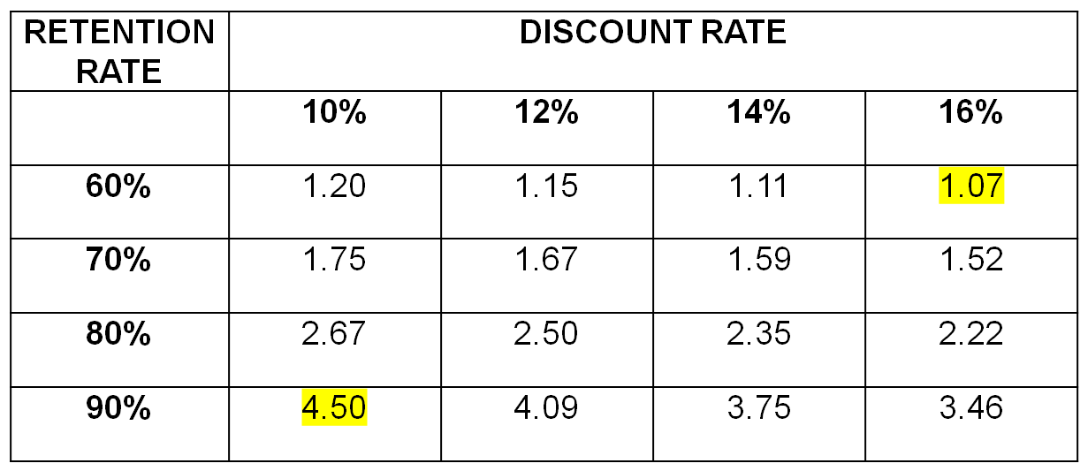
Margin multiples

Slide 22
Data-mining for CPM
Clustering techniques
  CART
  CHAID
Decision trees
Neural networks

Slide 23
Credit risk training set
Name | Debt | Income | Married? | Risk
Joe | High | High | Yes | Good
Sue | Low | High | Yes | Good
John | Low | High | No | Poor
Mary | High | Low | Yes | Poor
Fred | Low | Low | Yes | Poor

Slide 24
Cross-tab of dependent and independent variables
Predicted risk | High debt | Low debt | High income | Low income | Married | Not married
Good | 1 | 1 | 2 | 0 | 2 | 0
Poor | 1 | 2 | 1 | 2 | 2 | 1

Slide 25
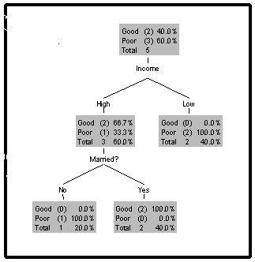
Decision tree output

Slide 26
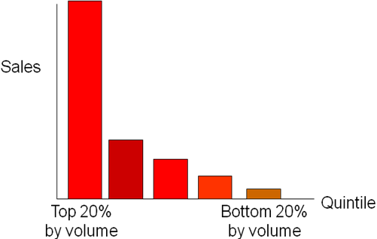
The 80:20 rule or Pareto principle

Slide 27
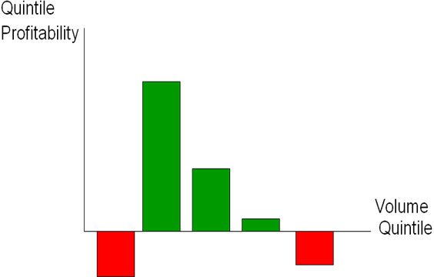
Customer profitability by sales volume quintile

Slide 28
Shapiro et al’s customer classification matrix
High
Carriage
trade
Passive
Received
price
Bargain
basement
Aggressive
Low
Low
High
Cost-to-serve

Slide 29
How costs vary between customers
Pre-sale costs | Production costs | Distribution costs | Post-sale costs
Geographic location: close v. distant | Order size | Shipment consolidation | Training
Prospecting | Set-up time | Preferred transportation mode | Installation
Sampling | Scrap rate | Back-haul opportunity | Technical support
Human resource: management v. reps | Customization | Location: close v. distant | Repairs and maintenance
Service: design support, applications engineering | Order timing | Logistics support e.g. field inventory

Slide 30
Fiocca step 1
Key difficult
Non-key difficult
High
Difficulty in
managing account
Key easy
Non-key easy
Low
High
Low
Strategic importance of account

Slide 31
Fiocca step 1: Strategic importance
Strategic importance is related to
  value/volume of the customer’s purchases
  potential and prestige of the customer
  customer market leadership
  general desirability in terms of diversification of the supplier’s markets, providing access to new markets, improving technological expertise, and the impact on other relationships

Slide 32
Fiocca step 1: Difficulty of managing relationship
Difficulty of managing the customer relationship is related to:
  product characteristics such as novelty and complexity
  account characteristics such as the customer’s needs and requirements, customer’s buying behaviour , customer’s power, customer’s technical and commercial competence and the customer’s preference to do business with a number of suppliers
  competition for the account which is assessed by considering the number of competitors, the strength and weaknesses of competitors and competitors’ position vis à vis the customer

Slide 33
Fiocca step 2
Assess key easy and key difficult accounts:
  The customer’s business attractiveness
  The strength of the buyer/seller relationship

Slide 34
Fiocca step 2: customer attractiveness
Market factors | Financial and economic factors
Size of key segments served by customer | Customer’s margins
Customer’s share of key segments | Customer’s scale and experience
Customer’s growth rate | Barriers to customer’s entry or exit
Customer’s influence on the market | Customer’s capacity utilisation
Competition in the customer’s market | Technological factors
Customer’s position and strength | Customer’s ability to cope with change
Customer’s vulnerability to substitutes | Depth of customer’s skills
Customer’s level of integration | Types of technological know-how
 | Level of customer patent protection
Socio-political factors
Customer’s ability to adapt and fit

Slide 35
Fiocca step 2: strength of relationship
the length of relationship
the volume or dollar value of purchases
the importance of the customer (percentage of customer’s purchases on supplier’s sales)
personal friendships
co-operation in product development
management distance (language and culture)
geographical distance

Slide 36
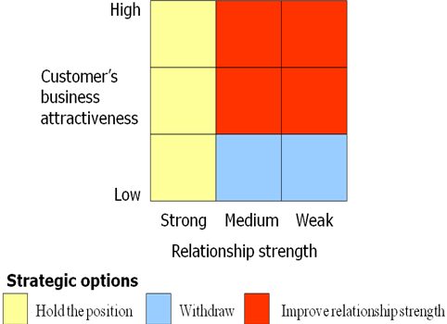
Fiocca step 2: strategic options

Slide 37
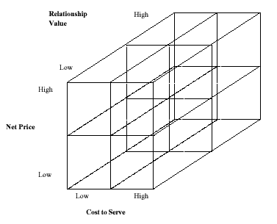
Turnbull & Zolkiewski’s 3D model

Slide 38
Additional CPA tools
SWOT analysis
PESTE analysis
5-forces analysis
BCG matrix analysis

Slide 39
PESTE analysis 1
Political environment
  Demand for international air travel contracted as worldwide political stability was reduced after September 11, 2001
Economic environment.
  Demand for mortgages falls when the economy enters recession
Social environment.
  As a population ages, demand for health care and residential homes increase

Slide 40
PESTE analysis 1
Technological environment.
  As more households become owners of computers, demand for internet banking increases
Environmental conditions.
  As customers become more concerned about environmental quality, demand for more energy efficient products increases

Slide 41
5-forces analysis
The profitability of an industry– as measured by its return on capital employed relative to its cost of capital – is determined by 5 sources of competitive pressure.
  competition within the established businesses in the market
  competition from potential new entrants
  competition from potential substitutes
  the bargaining power of buyers
  the bargaining power of suppliers.

Slide 42
BCG matrix
High
STAR
QUESTION MARK
Cash use equals
cash generation
Heavy cash users
Strategy: Aggressive growth or divest
Strategy: Grow and
build
Market
growth
CASH COW
DOG
Cash generators
Cash users
Strategy: Maintain and
milk
Strategy: Divest
Low
10x
1x
0.1x
Relative market share
Product evolution
Direction of cash movement

Slide 43
Strategically significant customers 1
High future life-time value customers.
  These customers will contribute significantly to the company’s profitability in the future
High volume customers.
  These customers might not generate much profit, but they are strategically significant because of their absorption of fixed costs, and the economies of scale they generate to keep unit costs low

Slide 44
Strategically significant customers 2
Benchmark customers.
  These are customers that other customers follow. For example, Nippon Conlux supplies the hardware and software for Coca Cola’s vending operation. Whilst they might not make much margin from that relationship, it has allowed them to gain access to many other markets. ‘If we are good enough for Coke, we are good enough for you’, is the implied promise. Some IT companies create ‘reference sites’ at some of their more demanding customers.

Slide 45
Strategically significant customers 3
Inspirations.
  These are customers who bring about improvement in the supplier’s business. They may identify new applications for a product, product improvements, or opportunities for cost reductions. They may complain loudly and make unreasonable demands, but in doing so, force change for the better.
Door openers.
  These are customers that allow the supplier to gain access to a new market. This may be done for no initial profit, but with a view to proving credentials for further expansion. This may be particularly important if crossing cultural boundaries, say between west and east.

Slide 46
SSC’s at a Scandinavian timber processor
This company considers 5 attributes in identifying their strategically significant customers
Economic return
Future business potential
Learning value
Reference value
Strategic value by
  providing access to new markets
  strengthening incumbent positions
  building barriers to new entrants

Slide 47
Seven core customer management strategies
Protect the relationship
Re-engineer the relationship
Enhance the relationship
Harvest the relationship
End the relationship
Win-back the customer
Start a relationship

